Slide 1

AI Powered Spam Classifier
Department Of Electronics and Communication
Team Mates:
P.BalaPrakash
S.Logeshwaran
J.Kishore Kumar
S.Bhuvanesh
V.Abishek
Team Name:
Tech_Finders

Slide 2
Problem Definition:
AI-powered spam classification is a critical computational task that harnesses the capabilities of machine learning models to autonomously identify and categorize unsolicited or undesirable messages, such as spam emails or comments, in contrast to legitimate and relevant content. This multifaceted challenge revolves around the intricate training of algorithms to dissect and recognize a myriad of features and patterns found within textual or multimedia content, enabling them to effectively differentiate between spam and non-spam items.
These discerning features include but are not limited to keywords, sender information, message structure, and user behavior. Through the continuous process of learning from new data, AI spam classifiers evolve and refine their accuracy over time. This ongoing adaptation leads to substantial improvements in the efficiency of email inboxes, social media platforms, and various other digital communication channels. By effectively filtering out unwanted content, these classifiers act as indispensable gatekeepers, safeguarding users from potentially harmful or irrelevant information and thereby enhancing their digital experience.

Slide 3
Objectives:
In the context of AI-powered spam classification, a well-rounded system typically incorporates several essential components:
1. *Training Data:* This foundational element consists of a diverse and meticulously labeled dataset of emails, encompassing both spam and legitimate messages. It serves as the primary source for teaching the machine learning model the patterns and characteristics that distinguish between the two categories.
2. *Machine Learning Model:* The heart of the system, this core AI algorithm utilizes the training data to learn and refine its ability to classify incoming emails as either spam or legitimate. The model can be based on various machine learning techniques, such as decision trees, support vector machines, or more advanced deep learning approaches.
3. *Feature Extraction Tools:* These tools are responsible for extracting relevant features from email content, which are essential for the model's decision-making process.
Feature extraction methods encompass text analysis, which evaluates the content for keywords, language patterns, and textual characteristics indicative of spam. Additionally, sender information, message structure, and other metadata can be vital features in the classification process

Slide 4
4. *User Feedback Mechanism:* To continually improve the classifier's accuracy and minimize false positives (legitimate messages classified as spam) and false negatives (spam messages allowed through), a user feedback mechanism is crucial. Users can report misclassified emails, helping to fine-tune the model and reduce errors over time.
5. *APIs (Application Programming Interfaces):* To make the spam classifier accessible and integratable into various applications, APIs are often provided. Developers can utilize these APIs to seamlessly incorporate the classifier into custom email clients, communication platforms, or other software.
These APIs enable the wider adoption of the spam classification technology, enhancing user experiences across diverse digital channels while ensuring the accuracy and efficiency of spam detection.The synergy between these components creates a robust and adaptable system for spam classification, capable of evolving and improving its performance continuously as it learns from user interactions and feedback. Such systems not only contribute to a cleaner and safer digital environment but also empower developers to integrate this technology into their applications and services, bolstering the overall quality of user interactions with digital communication channels.

Slide 5
Algorithm For Scaning Mail:
In the domain of AI-powered spam classification, a rich assortment of machine learning and deep learning techniques and methodologies play a crucial role in effectively distinguishing spam from legitimate emails. Each method offers its unique strengths and capabilities, contributing to the robustness and accuracy of spam filters.
*Support Vector Machines (SVM):* SVMs excel at segregating spam from non-spam emails by creating a hyperplane in a high-dimensional feature space, maximizing the margin between the two classes. Their effectiveness is particularly pronounced when dealing with complex and high-dimensional data.
*Decision Trees:* Decision trees are adept at constructing models by recursively analyzing email attributes, leading to binary decisions at each node. This approach allows them to capture essential features and criteria for categorizing emails as spam or non-spam, making them interpretable and useful for feature selection.*Random Forests:* Leveraging ensemble learning, Random Forests enhance classification accuracy by aggregating predictions from multiple decision trees. This mitigates overfitting risks and substantially improves the model's generalization performance, rendering them highly effective for spam detection.
*Neural Networks:* Neural networks, including advanced architectures like Long Short-Term Memory (LSTM) and Transformers, extract intricate and context-rich features from email content for precise classification. Their ability to learn complex patterns and relationships in textual data has significantly advanced content-based spam detection.
*K-Nearest Neighbors (K-NN):* K-NN classifies emails based on their similarity to previously labeled data points. It calculates distances between instances in a multi-dimensional space and assigns the class label based on the majority of the k-nearest neighbors, making it useful for identifying emails with characteristics akin to known spam or non-spam emails

Slide 6
.*Logistic Regression:* Logistic regression estimates the probability of an email being spam based on various features. It models the relationship between these features and the probability of being spam using the logistic function, offering simplicity and interpretability.
*Ensemble Methods:* Ensemble methods, such as bagging and boosting, combine predictions from multiple models to enhance overall accuracy. By leveraging the wisdom of multiple models, ensemble techniques provide robust and reliable spam classification results.
*Deep Learning (LSTM, Transformers):* Deep learning models, including LSTMs and Transformers, have revolutionized content-based spam detection. These architectures can extract intricate semantic and contextual information from email text, enabling highly accurate and adaptable spam classification, even with evolving spamming techniques.
*Feature Engineering:* Feature engineering is a critical process in which relevant attributes are extracted from email content and metadata. Thoughtfully designed features can significantly influence the performance of spam classifiers, allowing them to capture nuances in email data effectively. In the realm of AI-driven spam classification, the choice of methodology often depends on the specific characteristics of the data and the desired balance between interpretability and performance. By leveraging these diverse techniques and continuously evolving models, spam filters can effectively safeguard digital communication channels from unsolicited and potentially harmful content..

Slide 7
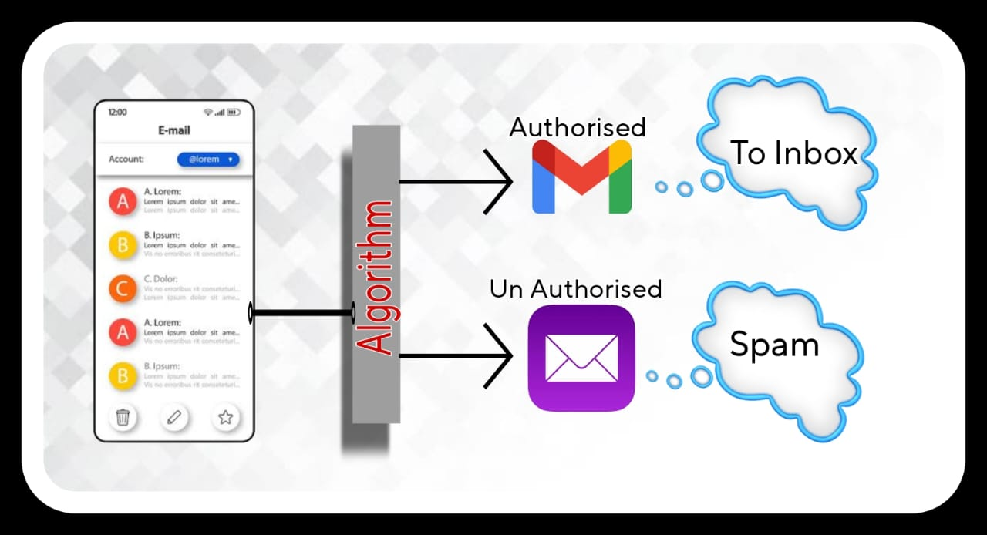
Flow Chart:

Slide 8
Mail Finding Approach:
Indicators of Legitimate Emails:
Indicators of legitimate emails serve as valuable guidelines for users in discerning genuine and trustworthy communication from the vast sea of messages in their inboxes. These indicators are not foolproof, but they provide essential clues that help users make informed decisions regarding the authenticity of an email:
1. *Known Senders:* Emails from known and trusted contacts or subscribed companies are typically genuine. If you've previously interacted with an individual or organization, there is a higher likelihood that their emails are legitimate. However, it's essential to remain cautious, as even known contacts can fall victim to email compromises
2. *Expected Content:* Legitimate emails often align with your interests or prior interactions. For instance, you might receive newsletters, updates, or transaction confirmations that are relevant to your past engagements or preferences. Be cautious if the content is entirely unrelated or seems out of place.

Slide 9
3. *Correct Spelling and Grammar:* Genuine emails typically maintain proper language. This includes correct spelling, grammar, and coherent sentence structure. Spammers and phishers often make errors in these aspects, which can be a red flag.
4. *Personalization:* Legitimate emails often address you by name and may reference past interactions. Personalization is a strong indicator of authenticity, as scammers typically use generic salutations or language that lacks personalization.
5. *Consistent Sender Information:* Verify that the sender's domain matches their claimed organization. Legitimate organizations maintain a consistent email domain, and their email addresses should match their official website's domain. Inconsistent or suspicious domains could indicate a fraudulent email.
6. *No Urgent Language:* Authentic emails typically avoid using threatening or overly urgent language. Phishing attempts often try to create a sense of panic or pressure to compel quick action. Legitimate communications provide information without resorting to such tactics.While these indicators can be helpful in identifying legitimate emails, it's essential to remember that email spoofing and phishing techniques are continually evolving. Therefore, users should always exercise caution and, when in doubt, verify the legitimacy of an email through independent means, such as contacting the supposed sender directly or visiting their official website. Vigilance and awareness are key to maintaining a secure and spam-free email experience.

Slide 10
Indicators of Spam Emails:
Recognizing indicators of spam emails is paramount for maintaining online safety and protecting personal information. These telltale signs are invaluable for users in identifying potentially harmful or unwanted messages:
1. *Unknown Senders:* Suspicious or unfamiliar email addresses are often the first red flag. Legitimate entities usually provide identifiable contact information, while spammers often use obscure or random email addresses.
2. *Language Errors:* Spam emails frequently contain grammatical mistakes and awkward sentence structures, as scammers may not pay as much attention to proper language use.
3. *Generic Greetings:* Beware of vague salutations like "Dear User" or "Hello Customer." Genuine organizations typically personalize their messages by addressing you by name.
4. *Unsolicited Attachments/Links:* Be cautious when encountering email attachments or links from unknown or untrusted sources. These can lead to malware, phishing sites, or other security threats.
5. *Info Requests:* Legitimate entities, such as banks or government agencies, will not request sensitive information like passwords or credit card details via email. Any such request should raise immediate suspicion.

Slide 11
6. *Too Good to Be True:* If an email promises unbelievable offers, winnings, or opportunities, it's often a scam. Spammers use the lure of enticing offers to trick recipients into taking action.
7. *Phishing URLs:* Hover your cursor over links to reveal the actual web address. Verify that the URL matches the legitimate website of the purported sender. Phishers often use deceptive links to direct users to fake sites.
8. *Unexpected Content:* Emails with entirely irrelevant or unsolicited content are likely spam. Be cautious when you receive messages that do not align with your interests or previous interactions.
9. *Urgency:* Emails that pressure immediate action, such as claiming your account will be suspended or that you've won a prize, are often tactics used by scammers to create a sense of urgency.
10. *Unsolicited Subscriptions:* If you didn't subscribe to receive emails from a particular source, it's likely spam. Legitimate marketing campaigns require your consent, and unsolicited subscriptions can be a sign of unwanted communication.By staying vigilant and recognizing these indicators, users can significantly reduce the risk of falling victim to spam, phishing, or other online scams. It's crucial to approach unsolicited or suspicious emails with caution and, if in doubt, verify the legitimacy of the sender or the content through independent and secure means.

Slide 12
Benefits:
The benefits of effectively identifying and filtering spam emails extend far beyond just decluttering your inbox. They encompass a wide range of advantages, making spam detection and prevention an integral part of an efficient and secure email experience.
1. *Enhanced Security:* The foremost advantage is the bolstering of personal and sensitive information security. Identifying and blocking spam emails safeguards users from phishing scams, malicious attachments, identity theft, and malware that can potentially compromise personal data and financial accounts
.2. *Time Savings:* Spam filtering ensures that users spend their valuable time on genuine and relevant messages. With less time wasted sifting through unwanted emails, individuals and organizations can significantly increase productivity and focus on meaningful tasks.
3. *Reduced Clutter:* By removing spam, inboxes remain organized and clutter-free. This not only makes it easier to find and manage important emails but also reduces the cognitive load associated with sorting through a myriad of irrelevant messages.
4. *Improved Email Performance:* Filtering out spam not only benefits users but also email servers. Lowering the volume of spam significantly reduces the strain on email infrastructure, resulting in faster and more reliable email services for everyone.
5. *Preventing Miscommunication:* Accurate email sorting helps prevent important messages from being overlooked or lost amid spam. This promotes effective communication and ensures that critical information is received and acted upon in a timely manner.
6. *Cost Savings:* Less spam translates to reduced data usage and lowers the risk of falling for fraudulent offers or scams that could result in financial losses

Slide 13
THANK YOU !!!

